Slide 1
Basic Structure of a PC
Input Devices
  Includes peripheral devices for getting data into the computer
CPU
  Arithmetic logic unit, performs calculations, high speed memory (cache RAM), set of storage locations (registers)
RAM
  Random Access Memory
Output
Devices
Memory
Input
Devices
CPU
Storage
Devices
  Output Devices
  Includes peripheral devices that display information received from the computer
  Storage Devices
  Secondary Memory non volatile storage. CD-ROMS, Disk Drives, Tape Drives

Slide 2
Input Output & Storage Devices
Input devices
  Keyboard
  Mouse
  Scanner
  Digital camera
Storage Devices
  Floppy disks
  Hard disks
  CD-ROM
  Magnetic Tape
  Removable disk
Output devices
  Monitor
  Printer
  LCD units

Slide 3
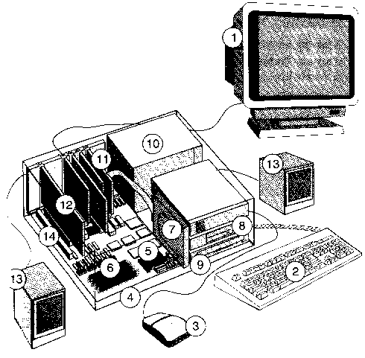
Parts Found in a System
Monitor
Keyboard
Mouse
Mother Board
CPU
RAM
HDD
1.44 FDD
CD- Rom
Power supply
Controller Card
Sound Card
Speakers
ISA Slot
VGA Card

Slide 4
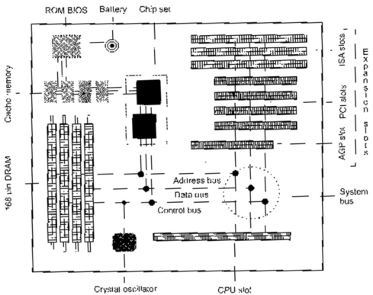
Motherboard
CPU
  Central Processing Unit
Chip set
  Manage the flow of data around the system bus
Crystal Oscillator
  Synchronises CPU operations, measured in MHz

Slide 5
Motherboard (cont)
RAM
  Memory that holds data while computer is running
ROM BIOS
  Holds a small amount of data when PC is off – enough to get it going again
System Bus
  Connects motherboard components

Slide 6
Motherboard (cont)
Expansion Slots
  Connects new devices to the computer
Cache Memory
  Fast memory used to speed the flow of data between CPU and RAM. Cache holds the most recently used data

Slide 7
System Bus
System Bus
  Set of wires that connect all components on the motherboard
Data Bus
  USED TO MOVE DATA ARROUND THE SYSTEM
Address Bus
  Used to let memory and peripheral devices know which data on the data bus is intended for them.
R
O
M
B
I
O
S
C
A
C
H
E
R
A
M
CPU
System Bus
Keyboard
interface
Video
Controller
Disk
Controller
Parallel
interface
Serial
interface

